Slide 1




THINK
FUTURE
ARTIFICIAL INTELLIGENCE &
MACHINE LEARNING
Tools used:
PYTHON
NUMPY
PANDAS
SCIKIT-LEARN
NAME: DURVESH MORE
COURSE: COMPUTER ENGINEERING
Artificial Intelligence (AI) is no longer just a futuristic idea—it’s a powerful tool shaping businesses today. From customer service to logistics, AI is driving efficiency, innovation, and new market opportunities across industries.

Slide 2
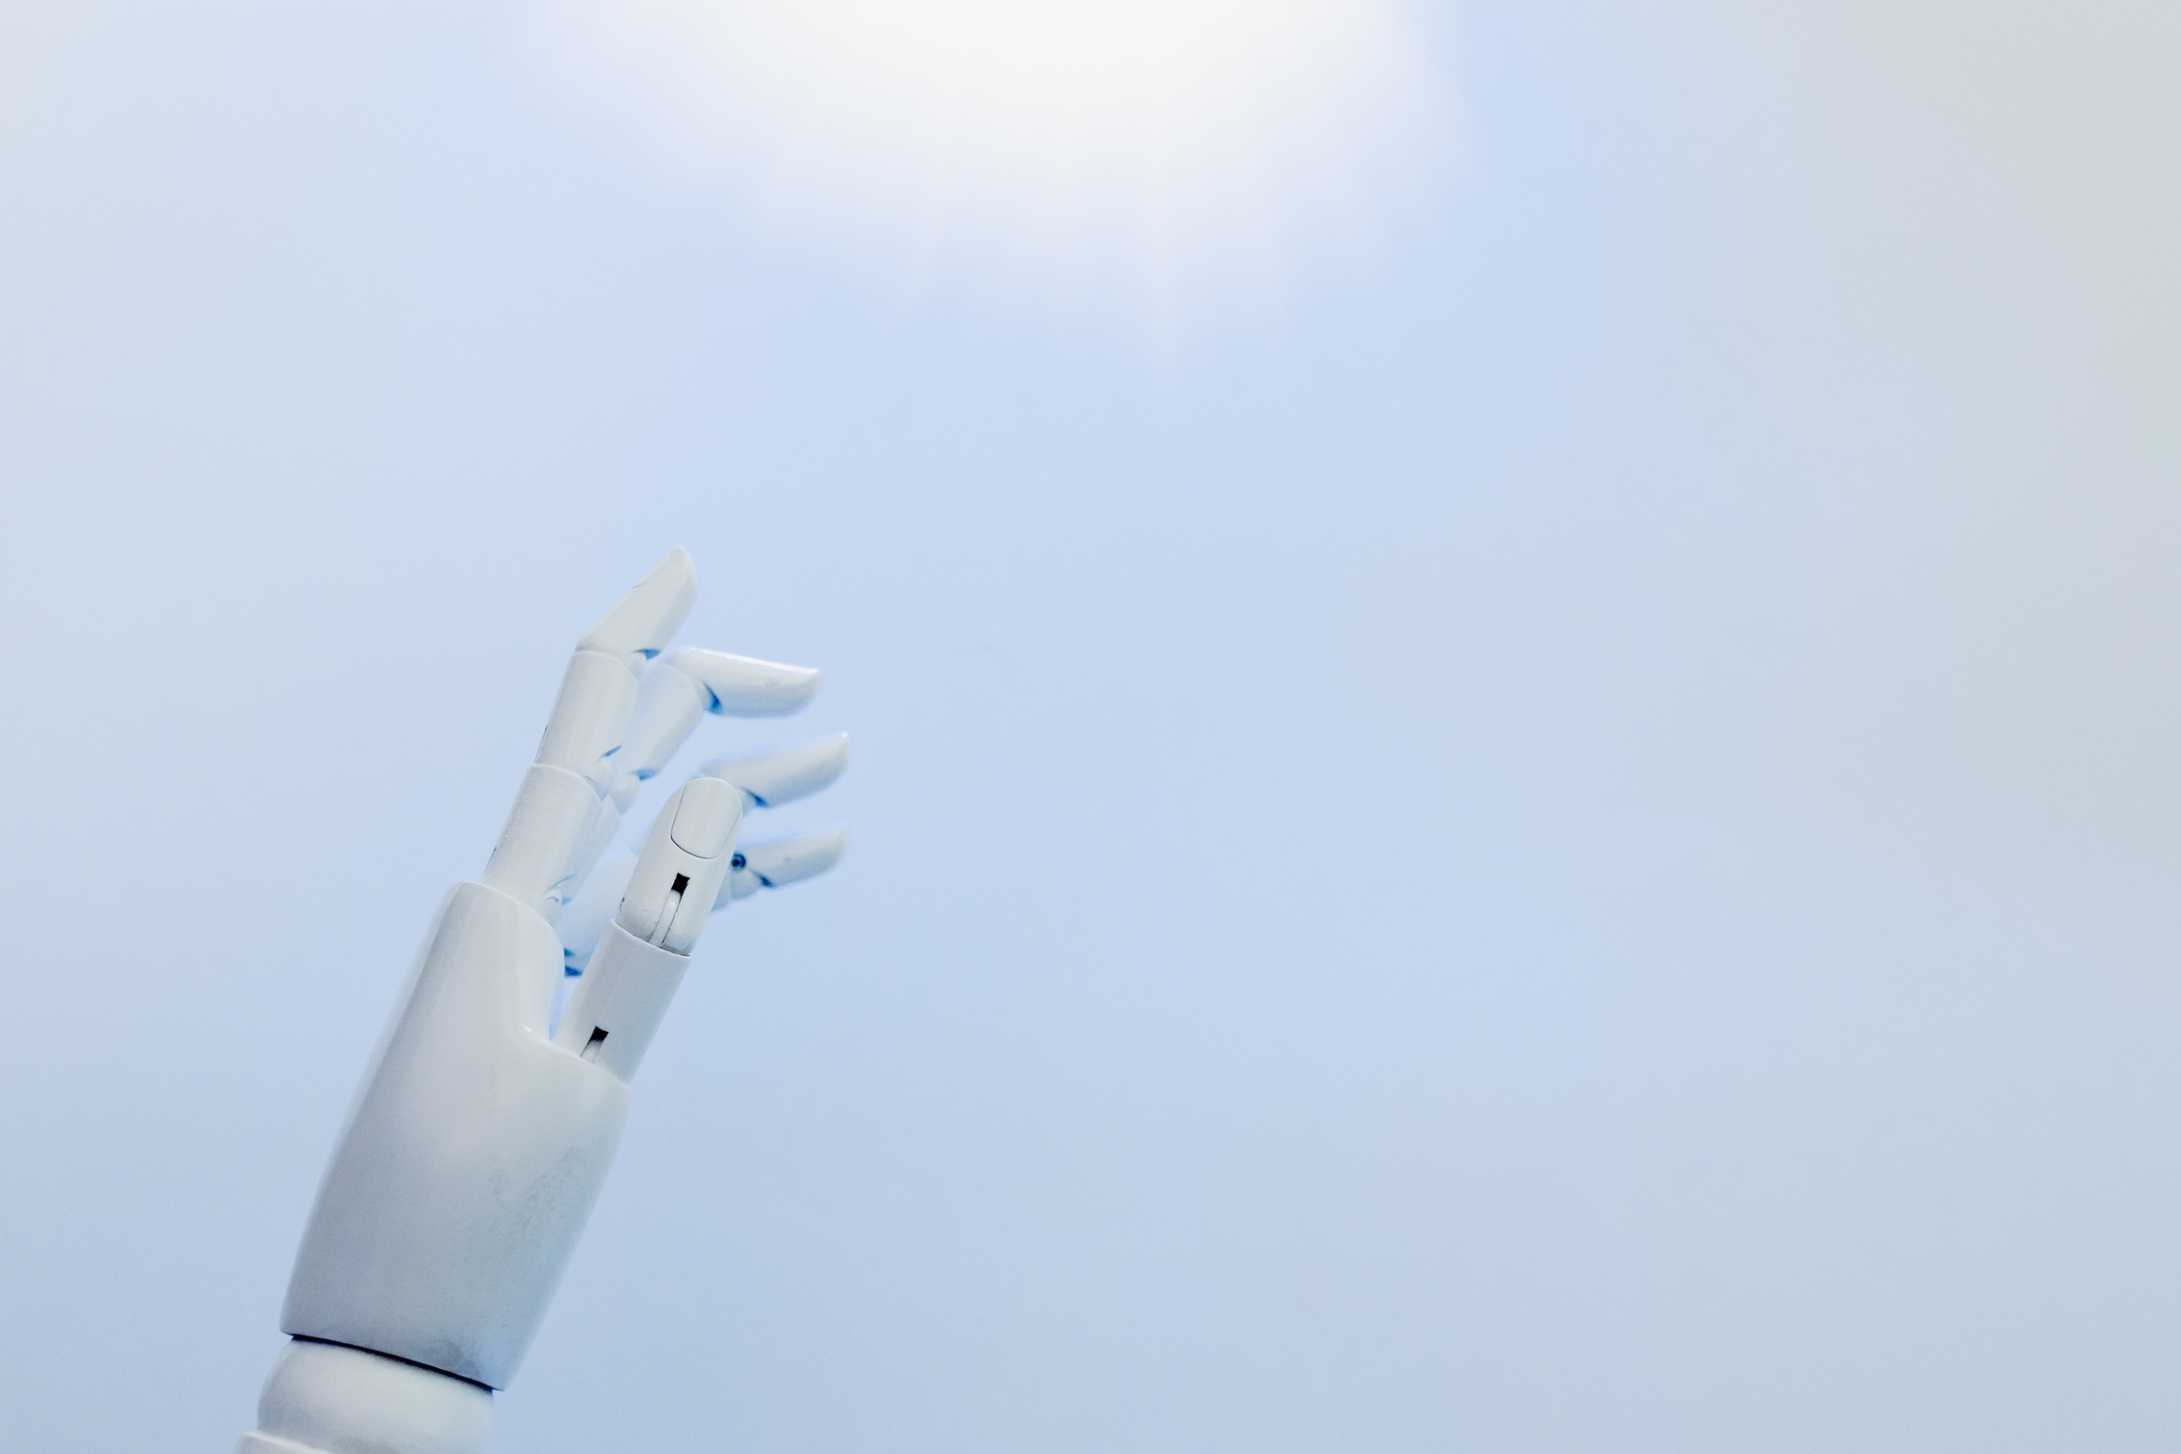
THINK
FUTURE
INTRODUCTION
OVERVIEW OF PROJECTS
AI technologies like machine learning, natural language processing, and automation are revolutionizing traditional business models. Companies are using AI to analyze big data, predict trends, personalize services, and streamline internal operations.
Collection of real-world Machine Learning projects
Covers classification and recommendation systems
Focus on predictive analytics and automation
End-to-end ML pipeline implementation
Projects deployed using Python

Slide 3
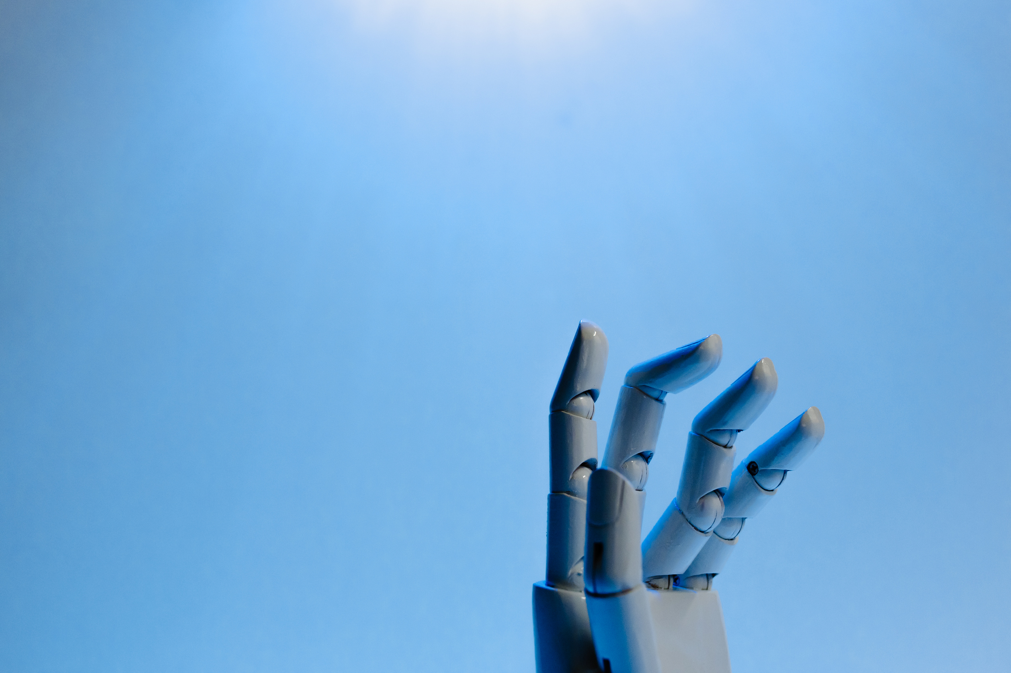
THINK
FUTURE
OBJECTIVES
Project Goals
Build accurate predictive models
Apply machine learning algorithms
Understand real-world datasets
Improve decision-making using data
Gain practical AI/ML experience
Several sectors are leading the adoption of AI, including healthcare, finance, retail, manufacturing, and transportation. Each industry uses AI in unique ways—from diagnosing diseases to optimizing supply chains—drastically improving results and customer satisfaction.

Slide 4
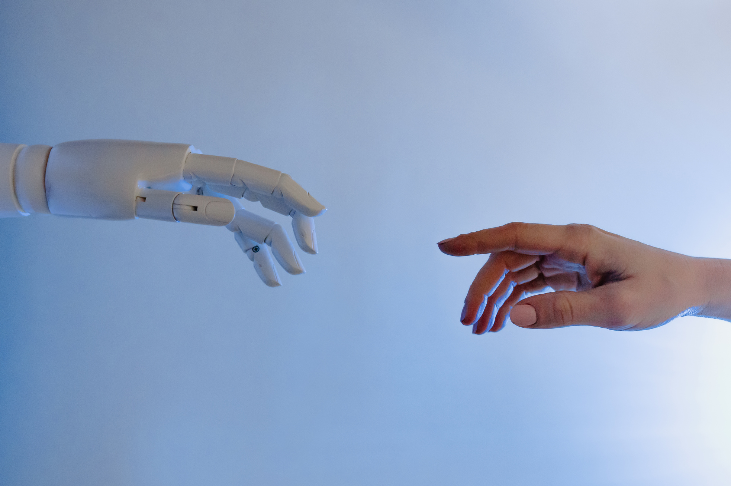
THINK
FUTURE
PROJECTS OVERVIEW
Projects Implemented
CUSTOMER CHURN PREDICTION
DIABETES PREDICTION
HEART DISEASE PREDICTION
LOAN STATUS PREDICTION
MOVIE RECOMMENDATION SYSTEM
SPAM MAIL DETECTION
Businesses are using AI to create more personalized, responsive, and engaging customer experiences. Chatbots, virtual assistants, and recommendation engines are helping brands stay connected to customers 24/7, enhancing loyalty and boosting sales.

Slide 5
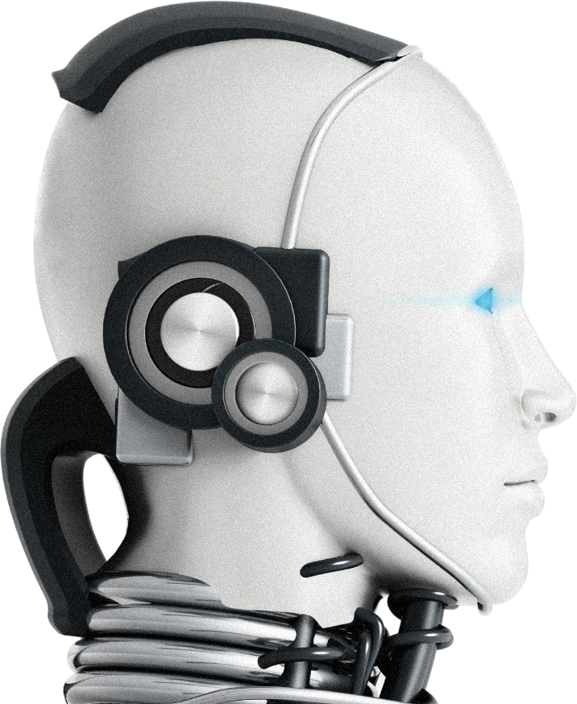
THINK
FUTURE
TECHNOLOGIES USED
AI thrives on data. Companies collect and analyze vast amounts of information to train AI models. Data-driven strategies allow businesses to make smarter decisions, uncover hidden insights, and innovate faster than ever before.
Tools & Libraries
Python
NumPy (Numerical Computation)
Pandas (Data Processing)
Scikit-learn (ML Models)
Matplotlib / Seaborn (Visualization)
Jupyter Notebook

Slide 6
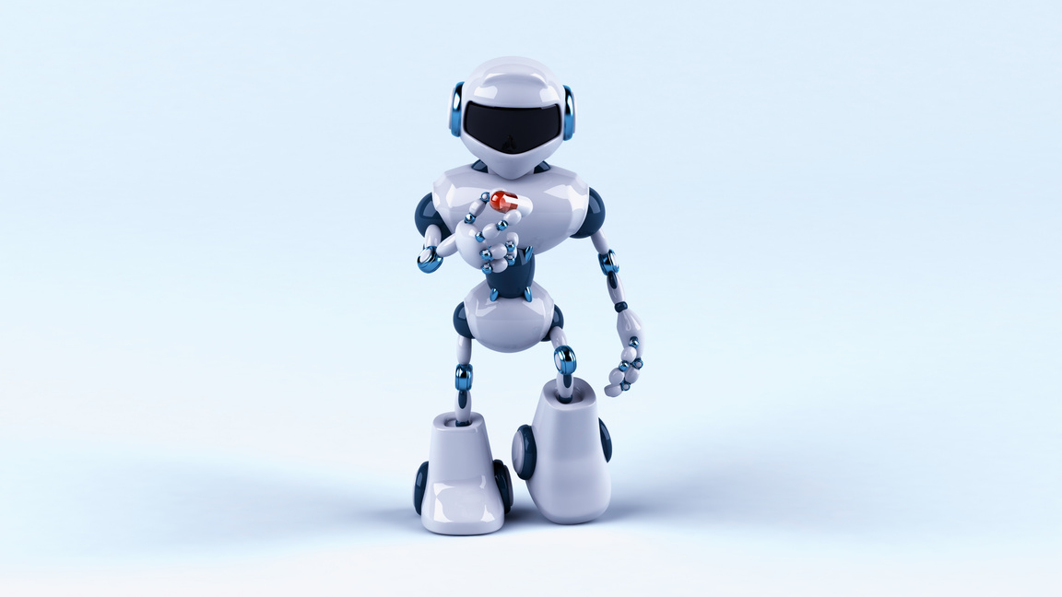
THINK
FUTURE
MACHINE LEARNING WORKFLOW
ML Pipeline
DATA PREPROCESSING
MODEL TRAINING
DATA
COLLECTION
Handling missing values
Encoding categorical data
Feature scaling
Businesses are using AI to create more personalized, responsive, and engaging customer experiences. Chatbots, virtual assistants, and recommendation engines are helping brands stay connected to customers 24/7, enhancing loyalty and boosting sales.
MODEL EVALUATION
PREDICTION

Slide 7
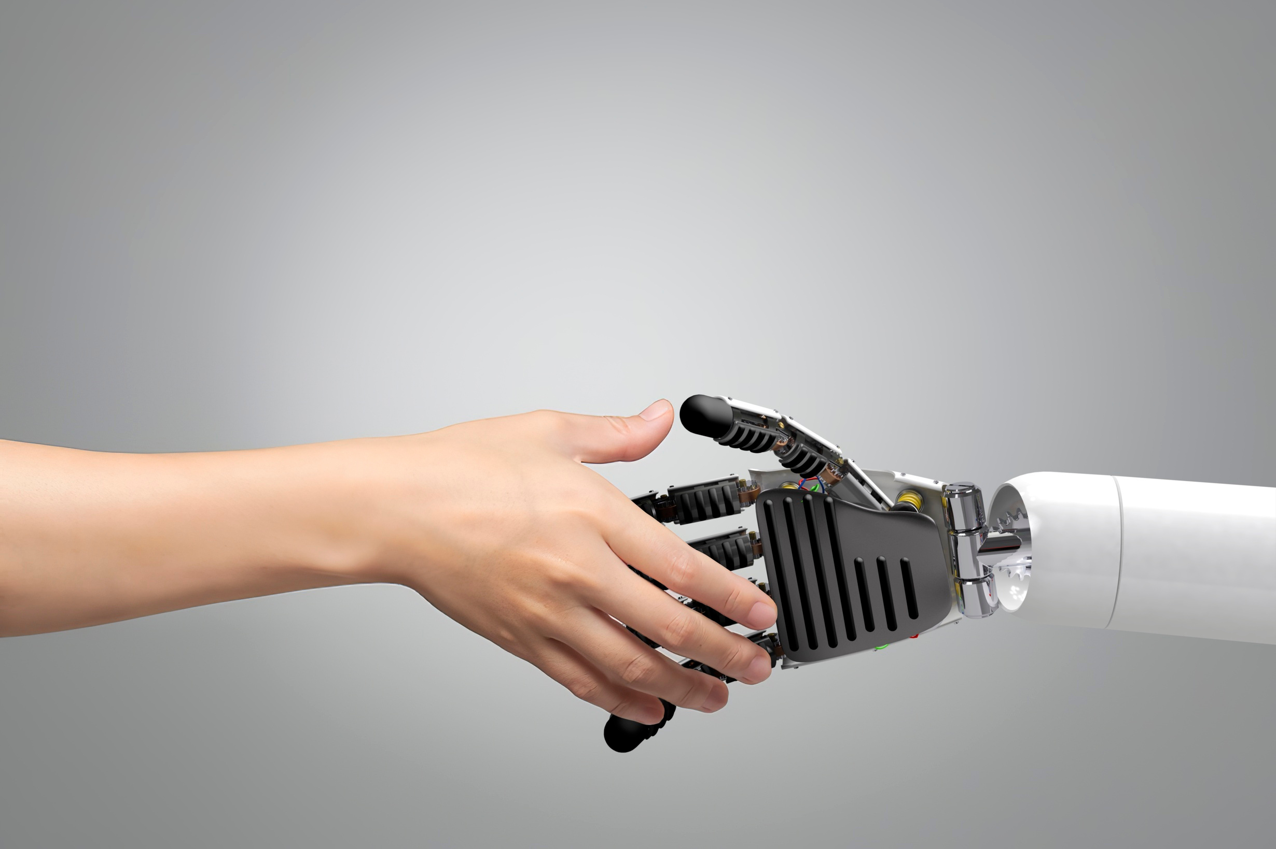
THINK
FUTURE
MODELS USED
LOGISTIC REGRESSION
RANDOM FOREST
DECISION TREE
SUPPORT VECTOR MACHINE (SVM)
K-NEAREST NEIGHBORS (KNN)
NAIVE BAYES
Algorithms Applied

Slide 8
THINK
FUTURE
PROJECT HIGHLIGHTS
Key Project Insights
CHURN PREDICTION → CUSTOMER RETENTION
DIABETES PREDICTION → HEALTH RISK ANALYSIS
HEART DISEASE → MEDICAL DIAGNOSIS SUPPORT
LOAN PREDICTION → FINANCIAL DECISION-MAKING
SPAM DETECTION → EMAIL FILTERING
RECOMMENDATION SYSTEM → PERSONALIZED SUGGESTIONS

Slide 9

THINK
FUTURE
RESULTS & PERFORMANCE
Model
Evaluation
ACCURACY USED AS PRIMARY METRIC
PRECISION & RECALL FOR CLASSIFICATION
CONFUSION MATRIX ANALYSIS
MODELS ACHIEVED GOOD PREDICTIVE PERFORMANCE
RESULTS DEPEND ON DATASET QUALITY

Slide 10
CONCLUSION & FUTURE SCOPE
THINK
FUTURE
Conclusion
SUCCESSFULLY BUILT MULTIPLE ML MODELS
GAINED HANDS-ON EXPERIENCE IN AI/ML
APPLIED ML TO REAL-WORLD PROBLEMS
Future Scope
USE DEEP LEARNING MODELS
DEPLOY MODELS AS WEB APPS
IMPROVE ACCURACY WITH LARGER DATASETS
INTEGRATE REAL-TIME PREDICTION SYSTEMS
-

